Slide 1
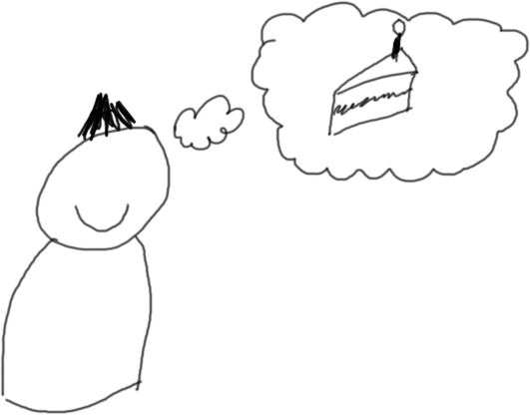
Inside the Mind of a Hiring Manager James Ashwin

Slide 2
Warning
I can’t draw.
I have consciously uncoupled myself from grammar and formatting.

Slide 3
Agenda
About me.
How I feel about recruitment.
What I look for.
How I look for it.
(and how to do well)

Slide 4
About me
Developer → Consultant → Developer
→ Dev Team Lead → Dev Manager → Head of Development
I have become cautious and hopeful about recruitment.

Slide 5
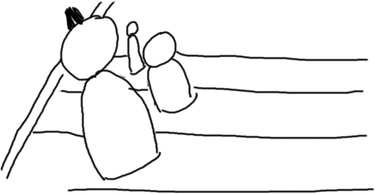
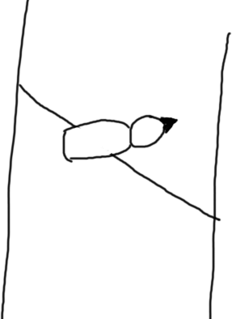

Caution: Hiring the right people is very important.
“Hire slow, fire fast!”
“Our people are our greatest asset!”
“Hire great people and get out of their way!”

Slide 6

Caution: Hiring people takes time.
275 → 186 (Other stuff)
189→ 99 (CV)
99 → 57 (Phone)
57→ 21 (F2F)
21→ 13 (Rejected us)
13 Hired!

Slide 7
Caution:
MOST IMPORTANTLY
Recruitment is a core competency of my job
so I have to hire good people!
FEAR

Slide 8
So I use one rule:
If it’s not a yes, it’s a no.
CAUTION

Slide 9
A non-exhaustive list of things I look for in candidates
(in no particular order)
Team fit
Technical competency
Flexibility
“Passion”
Diversity

Slide 10
Hopeful: Hiring people is also important
Better/faster/stronger
Or takes the pain away
(And the pain is double while recruiting!)
PRESSURE

Slide 11
MOST IMPORTANTLY
It impacts my bonus!
GREED

Slide 12
So I really want to say yes.
HOPE

Slide 13
So the key to getting hired:
Just do not give me a reason to not say yes.
Hint: The internet is really quite helpful.

Slide 14
CVs – What I’m looking for
Building a mental picture of you
How many of my boxes do you tick?
(Can you do, or grow into, the job?)
Does this feel like a logical step for you?

Slide 15
CVs – How you can help
2-3 pages, less waffle
Only things relevant to this role
Proactively explain gaps and where you’ve been
(I’m building a mental picture)
Simple. Clean. Accurate.
Be honest. BS smells.

Slide 16
Phone Interviews – What I’m looking for
Can you speak English?
Are you worth interviewing?
(and start gathering evidence)

Slide 17
Phone Interviews - Prep
Don’t be afraid to reschedule. We get it.
Find somewhere quiet. Landline is best.
Look on employer’s website.
Read job spec.
Read your own CV.
Read something about your industry.
eStalk interviewers. (??)

Slide 18
Phone Interviews – The call
They’ll probably call a couple of minutes late. Relax.
Say something out loud before you answer.
Answer with your name. Especially if it’s hard.
It’s all about getting to know each other.
Not too verbose. Not too short. Just right.
Be natural – not too polite. (??)
Have a couple of questions ready.

Slide 19
Face to face – What I’m looking for
Can you do the things your CV said?
Are you smart?
Do we get on?

Slide 20
Face to face – First contact
Go alone.
Be punctual. Not too early, either.
Dress sensibly.
Err on the smart side of casual.
(Personality is good, but it’s still an interview)
Eye contact. Firm handshake. Remember names.
(this is Interviewing 101 stuff)

Slide 21
Face to face – Inside the belly of the beast
Accept a drink.
Good for chit chat
Gives you a pause if you need one
Breaks eye contact
Start the interview with a “yes”
Try to relax.
Not too verbose. Not too short. Just right.
Be natural – not too polite. (??)

Slide 22
Face to face – Tips and tricks
“I don’t know” is OK.
(I’ll know you don’t know anyway)
Asking the answer is OK, too.
Practice competency-based questions.
I’m following a script – but it’s fun if it doesn’t feel that way.

Slide 23
Face to face – Finish him
Have a couple of questions ready.
End the interview with a “yes”
Build more conversation
Ask next steps if you want.

Slide 24
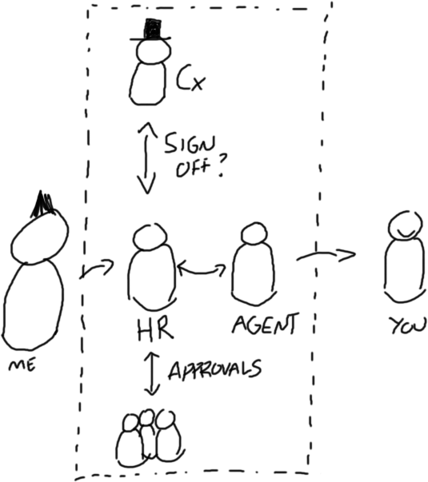
…but don’t try and close the deal:

Slide 25


